Slide 1
Titan Robotics Club
CAD TRAINING
Titan Robotics Club
Autodesk Inventor
#492, 3543, 6541
Day 1

Slide 2
INTRODUCTIONS
Titan Robotics Club
Welcome to FIRST and TRC!
#492, 3543, 6541

Slide 3
Goals of This Course
Knowledge
Experience
Teamwork
Titan Robotics Club
Learn about how to use Autodesk Inventor, as well as it’s various tools such as CAM
Practice your skills with projects that we may use to teach Robotics 101 students with
Learn to collaborate with a team, robotics isn’t a one person sport, it will help you in this club
#492, 3543, 6541

Slide 4
Course Contents
Menu Navigation
Sketching
01
02
03
Modeling
04
Assemblies
05
Importing
06
Drawings
Titan Robotics Club
Getting used to Inventor’s user interface
Creating 2D sketches in Inventor
Creating 3D objects in Inventor
Multipart assemblies as well as constraints
#492, 3543, 6541
Using 3rd party parts in assemblies
Creating drawings for fabrication

Slide 5
Today’s Schedule
01
03
02
04
Menu
Modify
Basic Sketching
Project
Titan Robotics Club
Getting used to Inventor’s interface
Modifiers in sketches
2D sketches using primitives
90 Degree Gusset Plate
#492, 3543, 6541

Slide 6
TECHNICAL STUFFS
Titan Robotics Club
#492, 3543, 6541

Slide 7
01
MENU
Titan Robotics Club
NAVIGATION
#492, 3543, 6541
A subtitle if I had one
Notes:
At this point you can switch to Inventor Demo’s I have an Annotation tool I use for that

Slide 8
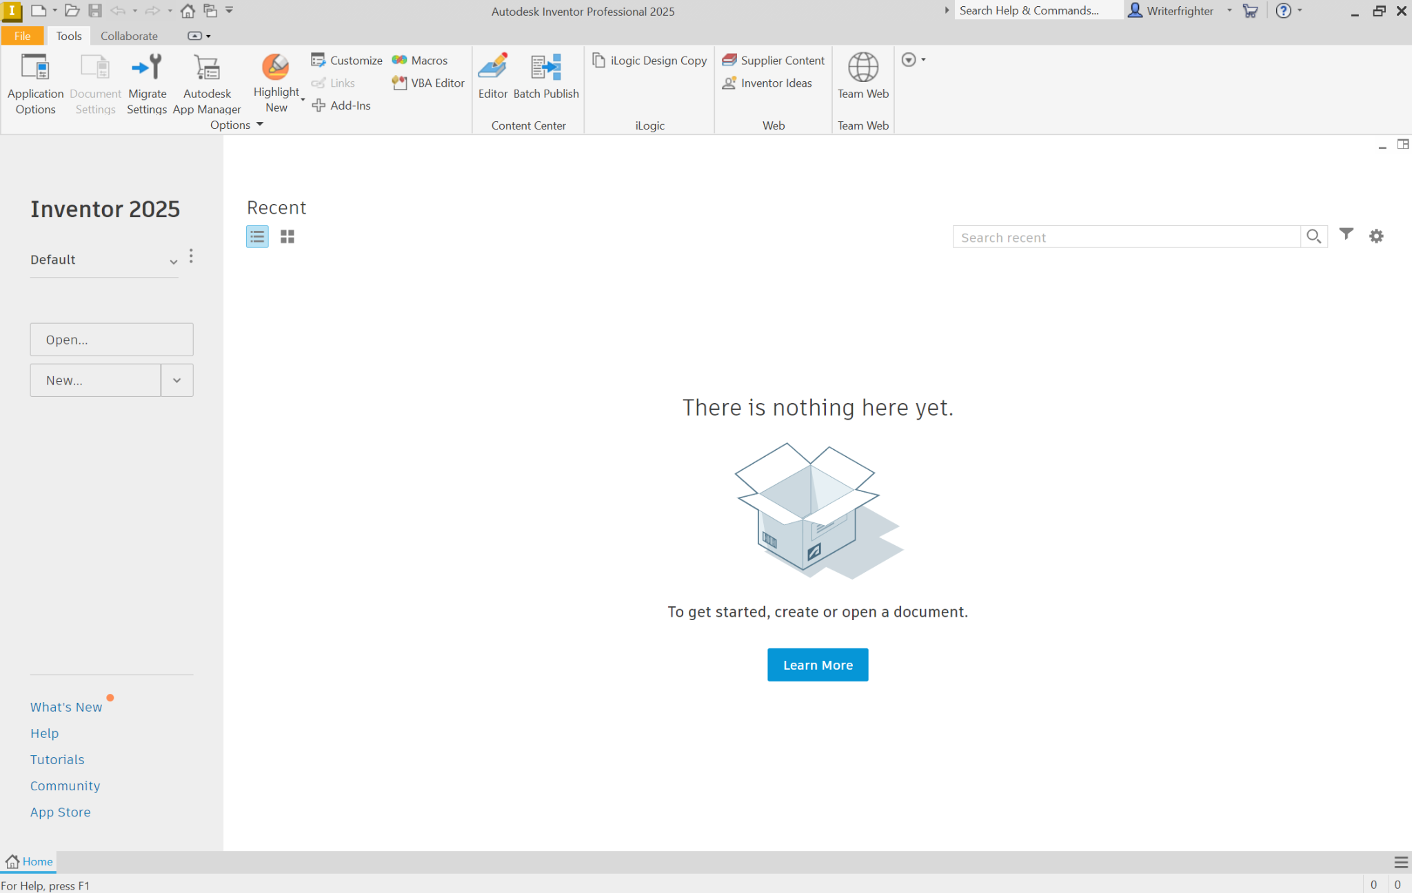
Ribbon
Project
Recent Files
Create
Tutorials (wow)

Slide 9
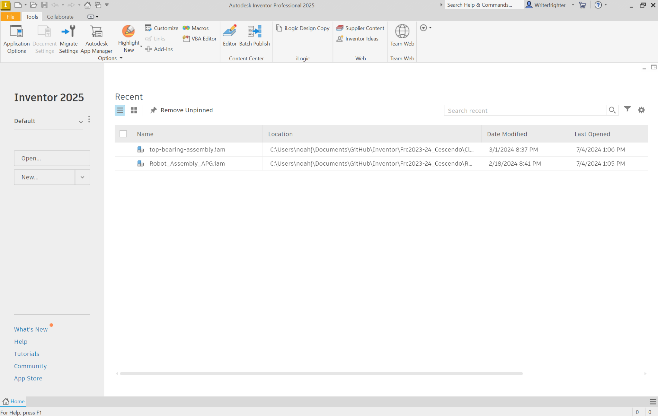
Ribbon
Project
Create
Recent Files
Tutorials (wow)

Slide 10
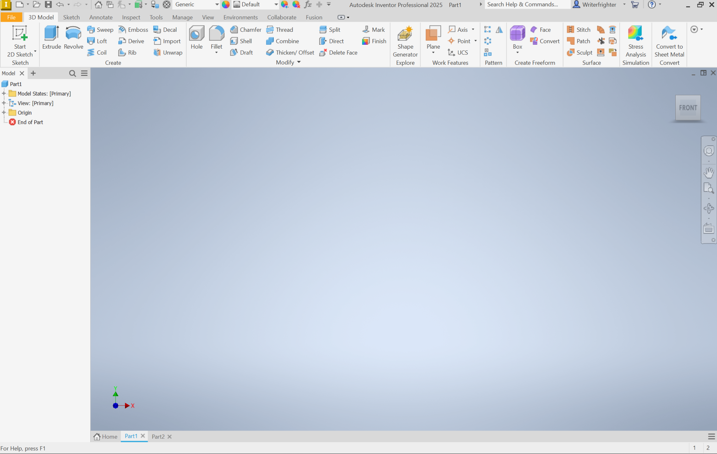
Ribbon
View Controls
Project Browser
Workspace
Tabs
Notes:
At this point go through each ribbon

Slide 11
Recap
Drafting & CAD Technology
Sketching
Major for college

Slide 12
RESOURCES
https://www.dropbox.com/sh/rmpjwhs7hfmgc6c/AAAEW-dNtnyRw6g4Ky4DkgbNa?dl=0 - 100+ Sketches you can practice with
https://www.autodesk.com/shortcuts/inventor - Inventor Shortcuts
https://www.youtube.com/watch?v=ODBUG6SKNSw&list=PLtakexwsjr-A7v36qlffbzK1VelyP5c3c - Inventor 2022
Autodesk Inventor 2024 - Clamp Part 1 (youtube.com)
E1 Autodesk Inventor 2025 | Basic Modeling for Beginners Tutorial with Training Guide (youtube.com)
https://www.youtube.com/watch?v=yk5zJ9WzM0s - Sketching 101
Titan Robotics Club
#492, 3543, 6541

Slide 13
THANKS!
Drafting & CAD Technology
Do you have any questions?
Coming up:
Tomorrow, 4-6PM
Next Week, 7-9PM
Major for college

